Slide 1
Classes 7, 8
Policies and Institutions: International by
Alan V. Deardorff
University of Michigan
2021
PubPol/Econ 541

Slide 2
Announcement
Quizzes
  Results:
 | Q1 | Q2 | Q3
Mean | 8.97 | 7.21 | 6.50
Median | 9 | 7.5 | 6.5
Max | 10 | 9.5 | 9.5
Min | 6.5 | 4 | 4
S.D. | 1.09 | 1.70 | 1.72

Slide 3
Announcement
Class recordings:
  Be patient, apparently
  Kept only 30 days (I think)
Quizzes
  Clarify my expectations:
    Feel free to look up anything you like from course or other sources.
    But write your answers yourself and do not work with other students.

Slide 4
Announcement
Papers
  Avoid “spurious specificity”
    Nothing here is known exactly
    So don’t report more than a few (3?) significant digits
    Eg, “$162 million”
      NOT “$161.629 million”
      NOT “$161,629,418

Slide 5
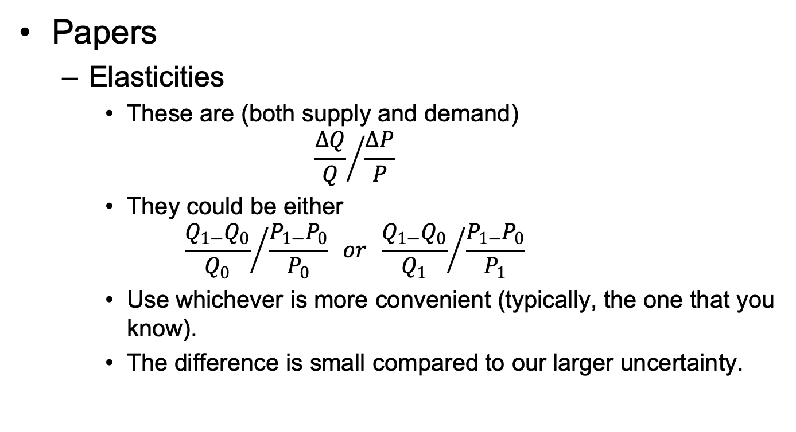
Announcement
Papers
  Elasticities
    These are (both supply and demand)
    $${\frac{∆Q}{Q}}/{\frac{∆P}{P}}$$
    They could be either
    $${\frac{Q_{1−}Q_{0}}{Q_{0}}}/{\frac{P_{1−}P_{0}}{P_{0}}} or {\frac{Q_{1−}Q_{0}}{Q_{1}}}/{\frac{P_{1−}P_{0}}{P_{1}}}$$
    Use whichever is more convenient (typically, the one that you know).
    The difference is small compared to our larger uncertainty.

Slide 6
Outline (for 2 classes)
The Problem
History
GATT
WTO
Issues
Other Institutions

Slide 7
The Problem
Countries think they can benefit themselves at the expense of others by using tariffs
But they all lose if all do
It’s a Prisoners’ Dilemma

Slide 8
The Problem of Trade Warfare
 | Japan
US |  | Free Trade |  | Protection
Free Trade |  |  | 10 |  | 20
 |  | 10 |  | –10
Protection |  |  | –10 |  | –5
 |  | 20 |  | –5
(Nash) Equilibrium

Slide 9
The Outcome
Countries use tariffs, and all are worse off
The solution: Cooperation
  Bilateral
    Pairs of countries agree to reduce tariffs on each other
    They worry that partners will later do better deals with others
    So they promise “Most Favored Nation”
      = Promise partners the best they do later for others
  Multilateral: GATT, and later WTO

Slide 10
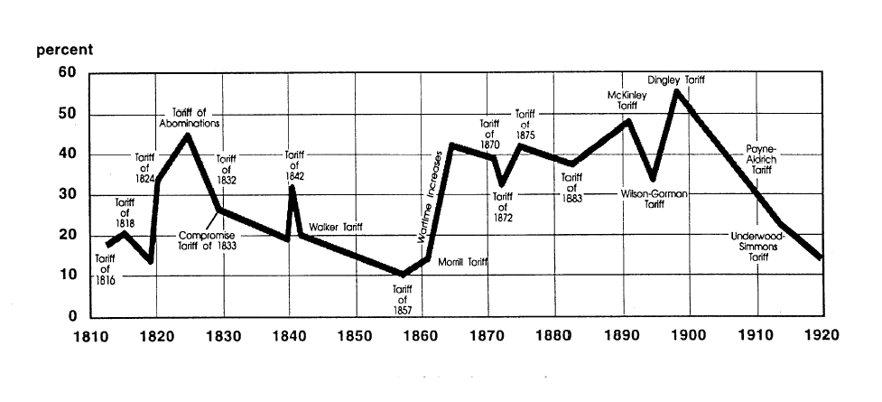
US tariff history: 1810-1920
Today
landandfreedoml.org
Notes:
Source: landandfreedom.org

Slide 11
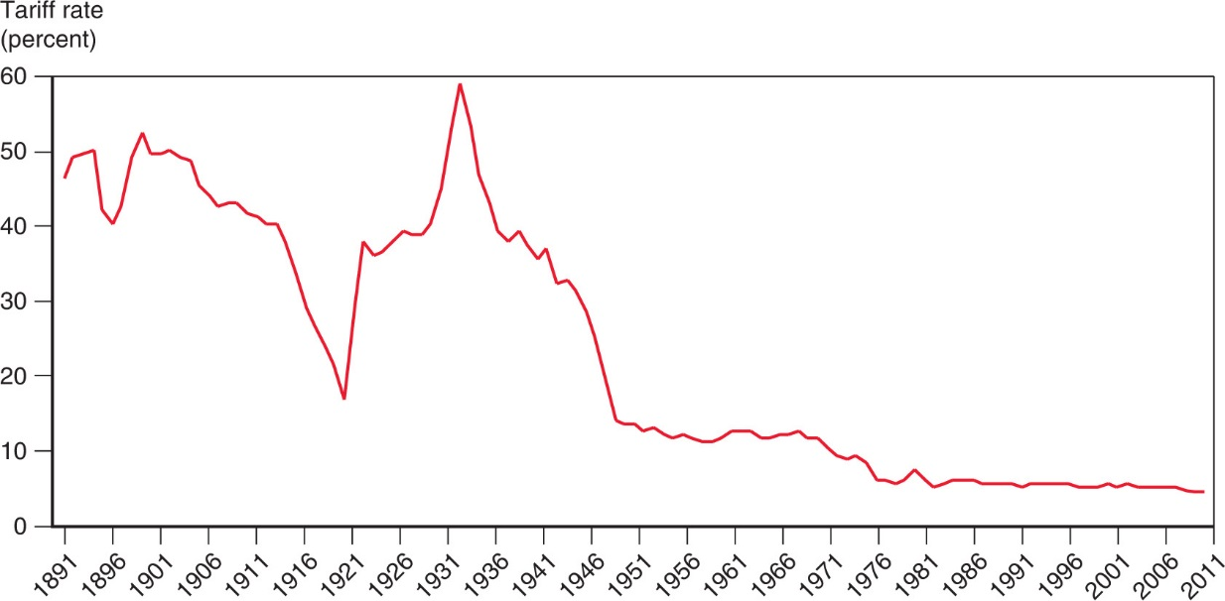
Figure 10.5 The U.S. Tariff Rate
Smoot-Hawley Tariff
1934 Reciprocal Trade Agreements Act
1947 GATT
1995 WTO
After rising sharply at the beginning of the 1930s, the average tariff rate of the United States has steadily declined.

Slide 12
History
Before 1934
  Massive use of tariffs
    Especially by US
    Often for government revenue
    Sometimes for protection of North-east manufactures
  1930: Smoot-Hawley Tariff
    Result of “logrolling” in Congress
    Prompted retaliation by others
    Worsened (did not cause) the Great Depression

Slide 13
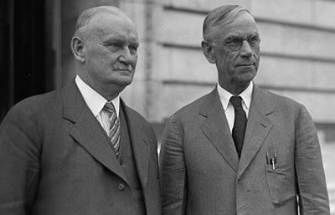
Hawley
Smoot

Slide 14
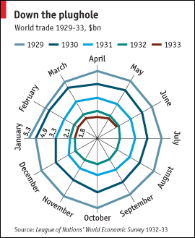
Kindleberger Spiral
Source: Economist, “The battle of Smoot-Hawley,” December 18, 2008.

Slide 15
History
1934: Reciprocal Trade Agreements Act
  US Congress authorized President to negotiate bilateral tariff reductions
  Used MFN to spread tariff cuts to, and from, multiple countries

Slide 16
History
1947: General Agreement on Tariffs and Trade (GATT)
  Accompanied (but not part of) the Bretton Woods negotiations that created
    IMF
    World Bank
  Meant as temporary until International Trade Organization (ITO) would be ratified.
    GATT was adopted via Protocol of Provisional Application
    ITO failed (in US)
  GATT become the rules for ~50 years by default

Slide 17
Pause for Discussion

Slide 18
  Questions on KOM
What reasons may motivate countries to use tariffs on imports?
By how much were US tariffs reduced from the 1930s to just after World War II, just before the GATT? How was this accomplished?
What do KOM mean by the “levers” and the “ratchets”?

Slide 19
GATT
What GATT does
  Sets rules for countries to follow in their trade policies
  Includes weak enforcement of rules
  Hosted “Rounds” of multilateral negotiations

Slide 20
GATT Negotiations
Rounds of GATT Multilateral Trade Negotiations
No. | Years | Name | Accomplishments
1-5 | 1947-61 |  | Reduced tariffs
6 | 1964-67 | Kennedy | Tariffs + anti-dumping
7 | 1973-79 | Tokyo | Tariffs + NTBs
8 | 1986-94 | Uruguay | Tariffs, NTBs, Services, Intellectual Property, Textiles, Ag., Dispute Settlement, Created WTO
9 | 2001-15 | Doha | FAILED: Doha Development Agenda

Slide 21
GATT Negotiations
How negotiations took place
  Tariffs:
    In early rounds, tariff cuts were negotiated between “principal supplier” country and “principal demander” country
      Cuts extended to all other members (MFN)
      Large countries dominated this process
    In more recent rounds, negotiations started with a formula for tariff cuts, then negotiated exceptions

Slide 22
GATT Negotiations
Swiss Formula:
Z = AX/(A+X)
    X = initial tariff rate
    A = coefficient and maximum tariff rate
    Z = resulting lower tariff rate
  Proposed by Switzerland in Tokyo Round
  Reduces high tariffs more than low tariffs

Slide 23
Pause for Discussion

Slide 24
  Questions on Jackson
What is the date of the Jackson book?
Was it written before or after:
  The expansion of world trade?
  The appearance of global supply chains?
  The creation of the WTO?
  The creation of the internet / web?
  The proliferation of Free Trade Agreements?

Slide 25
WTO
World Trade Organization
  Created by Uruguay Round, in 1994
  Went into effect Jan 1, 1995
  Members as of 2021: 164
    Latest: Afghanistan in 2016
  Led by Director General
    Position recently filled, after some controversy
    Little power

Slide 26
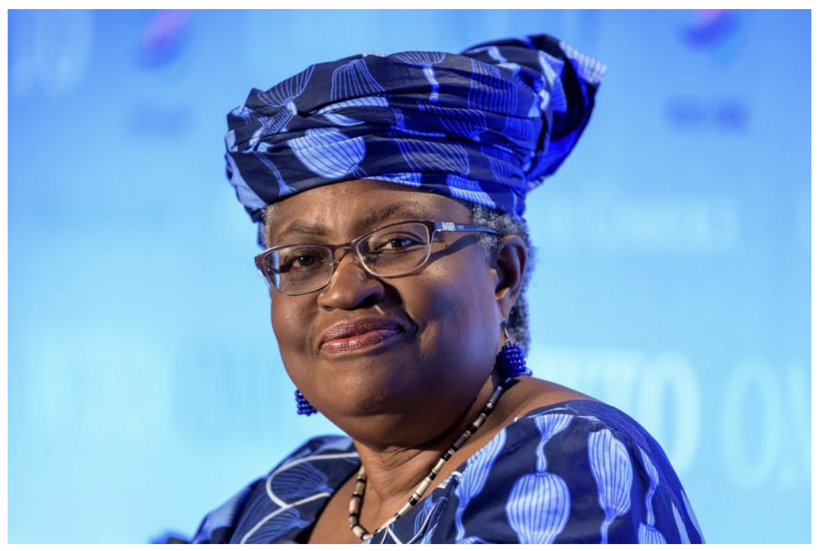
WTO Appoints Nigeria’s Ngozi Okonjo-Iweala as First Female Leader, Feb 15, 2021
Notes:
Norman, Laurence. “WTO Appoints Nigeria’s Ngozi Okonjo-Iweala as First Female Leader,” Wall Street Journal, February 15, 2021.

Slide 27
Pause for Discussion

Slide 28
  Questions on Norman
Why was the selection of Ms Okonjo-Iweala delayed?
What is Ms Okonjo-Iweala’s background?
What are the challenges that the WTO, and she, will face?

Slide 29
  Questions on Economist,
  “WTO has a new chief”
What in Ms Okonjo-Iweala’s background is suggestive of the issues that she’ll most want to deal with?
Why do some want to change the TRIPs rules of WTO, and does Ms Okonjo-Iweala agree with that?
What is the WTO’s stance on export restrictions to protect health?

Slide 30
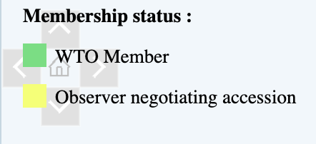
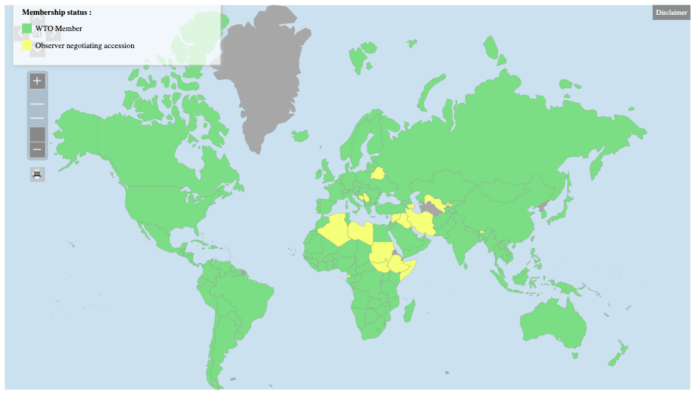
WTO
Notes:
https://www.wto.org/english/thewto_e/whatis_e/tif_e/org6_e.htm

Slide 31
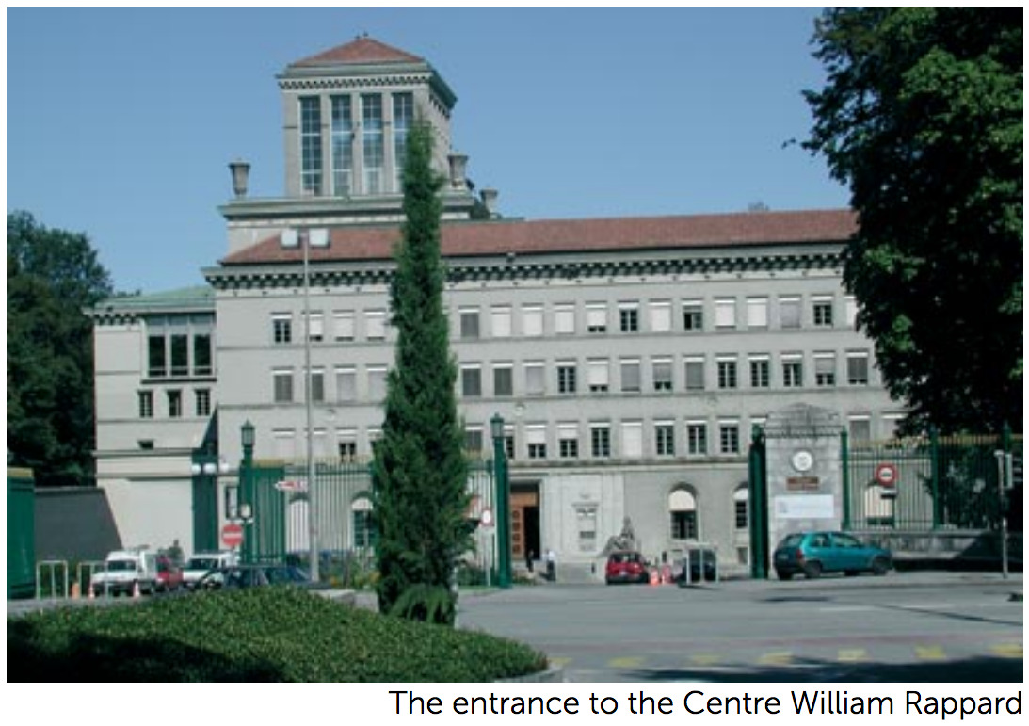

Slide 32
WTO
How it works
  Decides by “consensus”
    = “no member present objecting”
    Otherwise fraction (2/3 or 3/4) of all members
  In practice, major countries decide
  Ministerial meetings intended every two years
2 Fundamental principles
  MFN = Most Favored Nation
  National Treatment

Slide 33
Pause for Discussion

Slide 34
  Questions on Alden
Is it really “free trade” that Alden is saying we once had and now are losing?
Why are countries departing from nondiscrimination?
If the concerns that are motivating these policies are valid, why is he concerned?
What WTO principle should be given more emphasis?

Slide 35
  Discussion Question
What do you think the world of trade would be like now if we hadn’t had the GATT/WTO?

Slide 36
WTO
Three parts:
  GATT = General Agreement on Tariffs and Trade
  GATS = General Agreement on Trade in Services
  TRIPs = Trade-Related Aspects of Intellectual Property Rights
Functions (see below)

Slide 37
WTO Functions
Functional Outline of the World Trade Organization
Communication
Constraints
Exceptions
Dispute Settlement

Slide 38
WTO Functions
Communication | Ministerials
 | Negotiating Rounds
 | Working Groups
 | Trade Policy Review Mechanism
 | Councils and Committees
Trade Ministers (USTR, etc.) Meet “Every” Two Years
Tariff Reductions; Changes in Rules

Slide 39
WTO Functions
National Treatment for Service Firms (only in some industries)
Constraints | Tariff Bindings
 | Customs Valuation
 | Product Regulations
 | Quantitative Restrictions
 | Subsidies
 | Foreign Direct Investment (TRIMS)
 | Services (GATS)
 | Intellectual Property (TRIPs)
Countries negotiate and commit to maximum tariffs
Enforce Patents, Copyrights, Trademarks

Slide 40
WTO Functions
Most commonly used
Exceptions | Anti-Dumping
 | Countervailing Duties
 | Safeguards
 | Balance of Payments Protection
 | Preferential Trade Agreements
Permitted; not required
Allows NAFTA, EU, etc.

Slide 41
WTO Functions
Standing Committee that reviews most cases
Dispute Settlement | Consultation
 | Panel Recommendation
 | Appellate Body
 | Remedy | Implementation
 |  | Compensation
 |  | Retaliation
3-person Panel Decides Case
The Ultimate Remedy: Permit Tariffs

Slide 42
Pause for Discussion

Slide 43
  Questions on Jackson
Jackson lists 11 important achievements of the Uruguay Round in its creation of the WTO. Are any of them flawed or incomplete in his view or others’?
What are the two principles that promote nondiscrimination? Are there exceptions to these principles?
Does the WTO permit export subsidies? Why or why not?

Slide 44
WTO Early Issues
Seattle Ministerial – December 1999
  Intended to start a new Round
  Protesters flocked to Seattle, with objections
    Labor issues
    Environmental issues
    Corporate dominance
    Lack of transparency, democracy

Slide 45
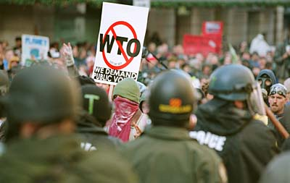

Slide 46
WTO Early Issues
Doha Round
  Began at WTO Ministerial at Doha, Qatar, Fall 2001 (after Sep 11)
  Emphasis on development:
  Cancún Ministerial Sep 2003
    Meeting ended without agreement: Failure!
  December 2015: Nairobi Ministerial meeting
    Ended without reaffirming intent to complete the Doha Round
    Implicitly, admission Round had ended in failure

Slide 47
WTO Early Issues
December 2013: Bali Ministerial salvaged a limited agreement, mainly on Trade Facilitation
December 2015: Nairobi Ministerial agreed on several commitments, including
  Abolished export subsidies on farm exports.
December 2017: Buenos Aries Ministerial met but accomplished essentially nothing
[Missed meeting in 2019; not sure why]
November 29, 2021: Geneva, Switzerland
  Originally planned for Nur-Sultan, Kazakhstan, June 8-11, 2020. Put on hold due to COVID-19, then rescheduled for Geneva

Slide 48
WTO Early Issues
WTO has also succeeded in negotiating “plurilateral agreements”
  These are agreements the members can sign or not, and are only binding on those who do
  Agreements that have been negotiated:
    Information Technology Agreement (1995 with update 2015)
    Financial Services Agreement
    Basic Telecommunication Services Agreement
    Anti-Counterfeiting Trade Agreement

Slide 49
WTO Disputes
There have been 606 disputes brought to the WTO since its creation in 1995 (as of 9/15/21)
Two of the more notable were
  EU ban on hormone treated beef (ruled by WTO to have no scientific basis)
  US shrimp-turtle import prohibition (struck down by WTO)

Slide 50
WTO Disputes
Boeing-Airbus (see our earlier readings)
COOL dispute (Country of Origin Labeling)
  US requires it on meat
  Canada and Mexico objected
  US lost
China’s “Market-economy status” for anti-dumping cases
  China lost

Slide 51
Trump and the WTO
Oct 25, 2017, on Fox interview with Lou Dobbs:
  “The WTO, World Trade Organization, was set up for the benefit for everybody but us.”
  “we lose the lawsuits, almost all of the lawsuits … within the WTO”
In fact, like other countries, US
  Wins most of the cases it brings
  Loses most the cases brought against it
Since 1995, in all cases complainant has won 90%
  As complainant, US has won 91%
  As respondent, US has lost 89%

Slide 52
Trump and the WTO
National-Security Tariffs (on steel, aluminum)
How will WTO rule?
    If no, Trump will further blame WTO
    If yes, other countries will use that excuse
WTO provision:
  Article XXI: “[n]othing in this Agreement shall be construed . . . to prevent any contracting party from taking any action which it considers necessary for the protection of its essential security interests . . . taken in time of war or other emergency in international relations[.]”

Slide 53
Trump and the WTO
National-Security Tariffs (on steel, aluminum)
How will WTO rule?
    If no, Trump will further blame WTO
    If yes, other countries will use that excuse
WTO provision:
  Article XXI: “[n]othing in this Agreement shall be construed . . . to prevent any contracting party from taking any action which it considers necessary for the protection of its essential security interests . . . taken in time of war or other emergency in international relations[.]”

Slide 54
Trump and the WTO
Dispute Settlement Body (DSB)
  Lacks a quorum since Dec 11, 2019
  Trump blocked all new appointments
Without DSB no case can finish if it is appealed
Other countries are forming an alternative mechanism
  See Amerjee

Slide 55
Trump and the WTO
Trade war with China
  Tariffs levied under US Section 301 not consistent with GATT/WTO
  WTO panel ruled against US Sep 15, 2020
    Panel: “Trump’s tariffs violated several global rules” (NYT)
  Case cannot be completed if US appeals
  Even without that, would WTO permission for China to levy tariffs be meaningful?

Slide 56
Trump and the WTO
Lighthizer (NYT 9/15/2020)
  “This panel report confirms what the Trump administration has been saying for four years: The W.T.O. is completely inadequate to stop China’s harmful technology practices”
  “Although the panel did not dispute the extensive evidence submitted by the United States of intellectual property theft by China, its decision shows that the W.T.O. provides no remedy for such misconduct.”

Slide 57
Biden and the WTO
Biden’s “Trade Policy Agenda” (see next class) includes:
  “Reengage and be a leader in international organizations, including the World Trade Organization”
  Does not mention fixing the Appellate Body
But Bloomberg Feb 22 headlines: “Biden Picks Up Where Trump Left Off in Hard-Line Stances at WTO”
  Insists on “national security” exemption
  “Biden administration said it would not agree to appoint new members to the WTO’s appellate body” due to “systemic concerns” with its functioning
Notes:
Baschuk, Bryce, “Biden Picks Up Where Trump Left Off in Hard-Line Stances at WTO, Bloomberg, Feb 22, 2021.
https://www.bloomberg.com/news/articles/2021-02-22/biden-picks-up-where-trump-left-off-in-hard-line-stances-at-wto

Slide 58
Fixing the WTO
Does the WTO need fixing?
  Trump thought so (or just kill it)
  Biden shares concerns about Appellate Body
  New DG Okonjo-Iweala says WTO hasn’t helped in the pandemic
    It permits trade restrictions to protect health
    It requires they be reported, but often they aren’t

Slide 59
Fixing the WTO
Does the WTO need fixing?
  “Intellectual property rules are too rigid, and protect pandemic profiteers over the poor”
    Some want to drop patents for vaccines. But DG O-I does not
  Rodrik critiques (of both WTO and FTAs)
    With tariffs reduced under GATT, WTO shifted from resisting import protection to promoting interests of exporters
    GATS and TRIPs agreements were results of big business lobbying

Slide 60
Pause for Discussion

Slide 61
  Questions on Amerjee
What does MPIA stand for, and why was the MPIA needed?
What countries will be bound by the MPIA? (Who will not be bound?)
Who will decide cases?
Will this work any better than the Appellate Body? Why or why not?

Slide 62
  Questions on Rodrik
  [NOTE: Much of Rodrik critique is about FTAs, not WTO, so I’ll have questions on that later.]
How does Rodrik change the political economy of trade policy?
Why are the welfare effects different?
What groups of companies does Rodrik criticize specifically?

Slide 63
Other International Institutions
IMF (International Monetary Fund)
World Bank (International Bank for Reconstruction and Development)
G-7, G-8, G-20
OECD (Organization for Economic Cooperation and Development)
EU (European Union)

Slide 64
Other International Institutions
United Nations
  UNCTAD (United Nations Conference on Trade and Development)
  ILO (International Labor Organization)
  WIPO (World Intellectual Property Organization)
FTAs (Free Trade Agreements)
  USMCA (United States Mexico Canada Agreement)
  CPTPP (Comprehensive and Progressive Agreement for Trans-Pacific Partnership)
  RCEP (Regional Comprehensive Economic Partnership)
  Many others …

